Slide 1
Object follower bot

Slide 2
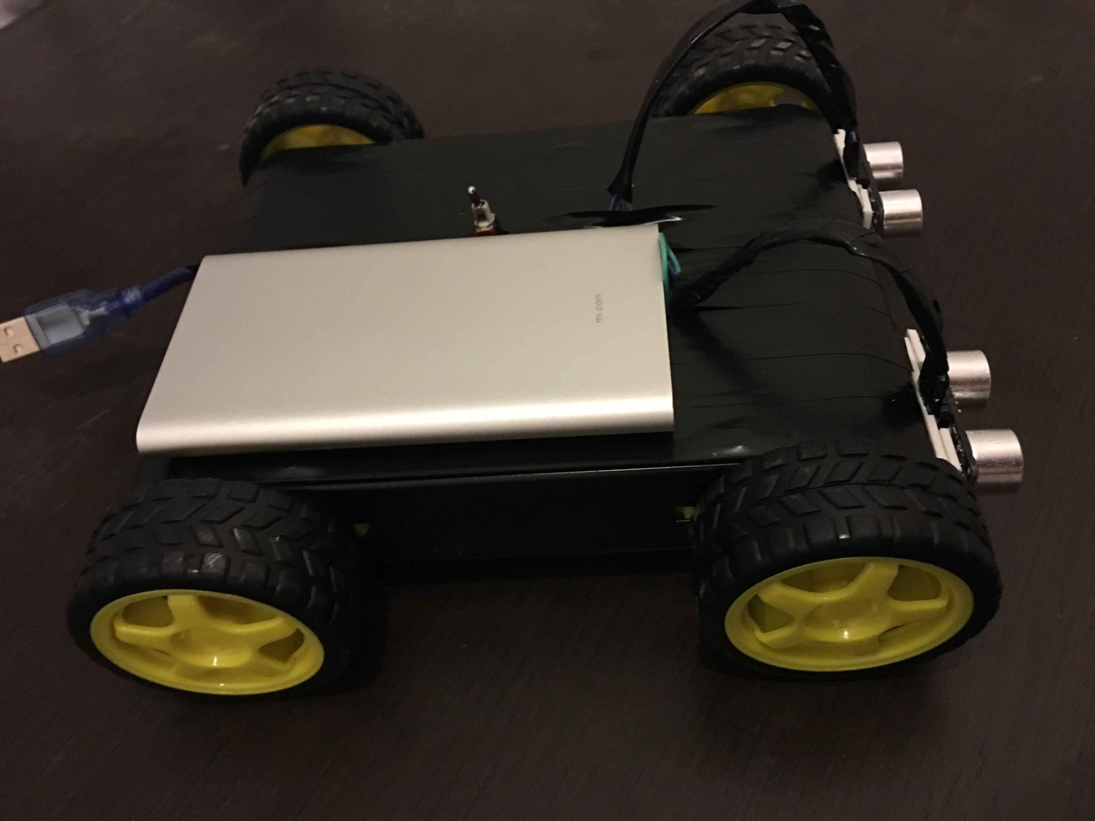
Introduction:
“Object follower bot” was chosen because of the possibility of using similar ideas and technologies in solving of real problems.
Different parts of the project:
Chassis.
Main body part.
Distance sensors.
Direction sensors.
Microcontroller.
Control strategy.
Power supply source.
Cover/shape of the body part.

Slide 3
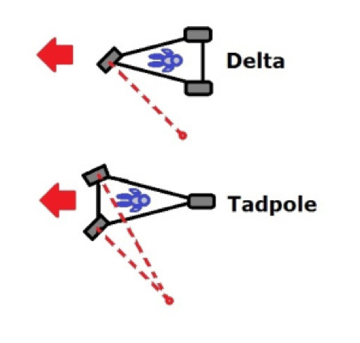
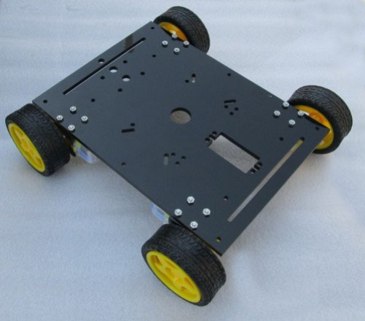
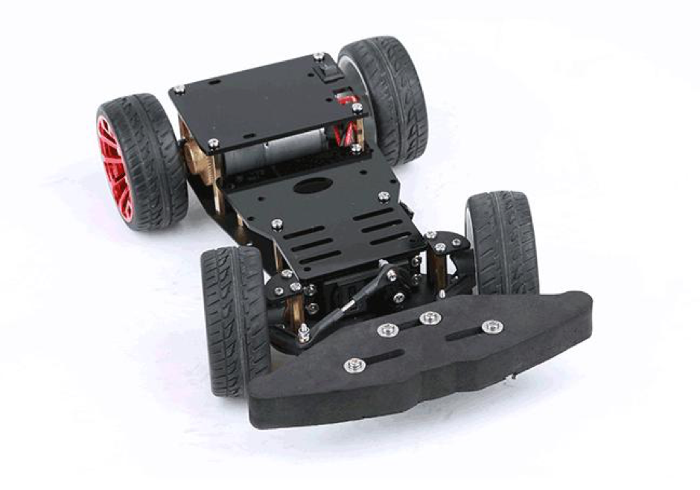
Chassis:
3 wheels chassis:
There are 2 different types of 3 wheels chassis :
Delta (one wheel in front, two in back);
Tadpole (two wheels in front, one in back).
4 wheel chassis:
4 wheels drive (when all for 4 wheels rotate in necessary direction);
2 wheels back wheels drive and 2 front wheels change direction.

Slide 4
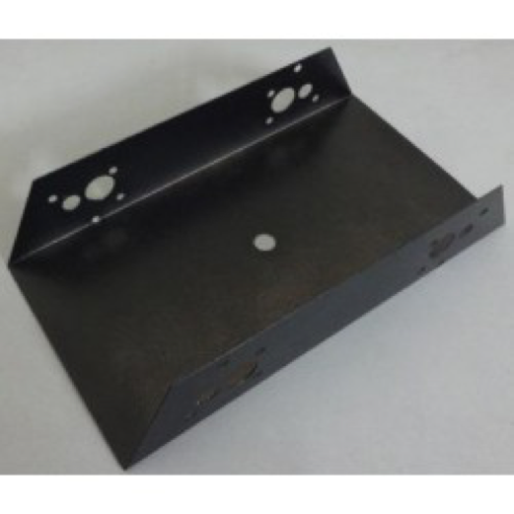
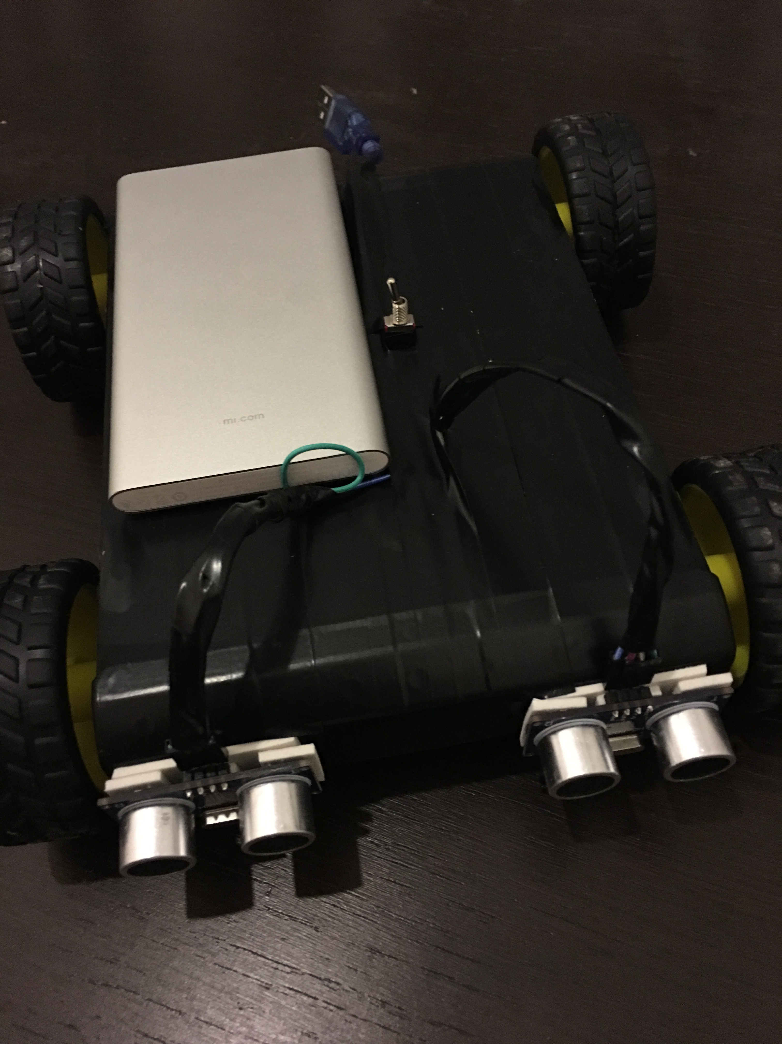
Main body:
This is the part of the robot on which we will put all the main components, such as wheels, microcontroller, H-bridge, sensors, DC motors and etc.
Different materials:
Plastic;
Wood;
Metal.

Slide 5
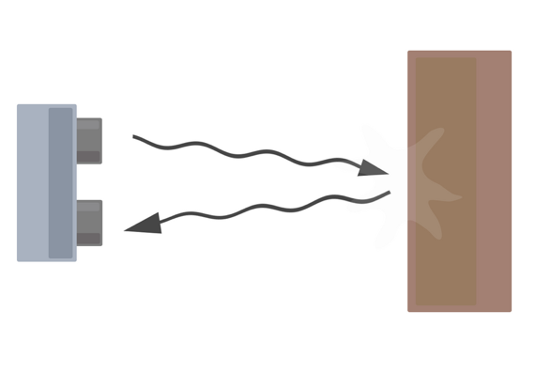
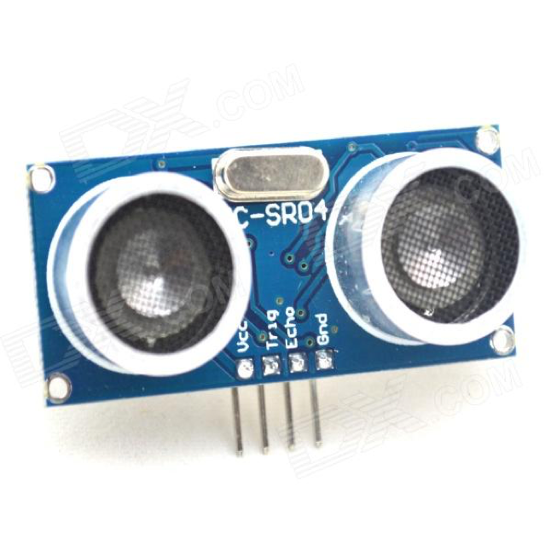
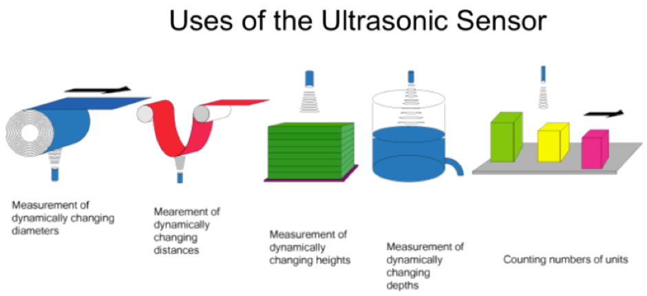
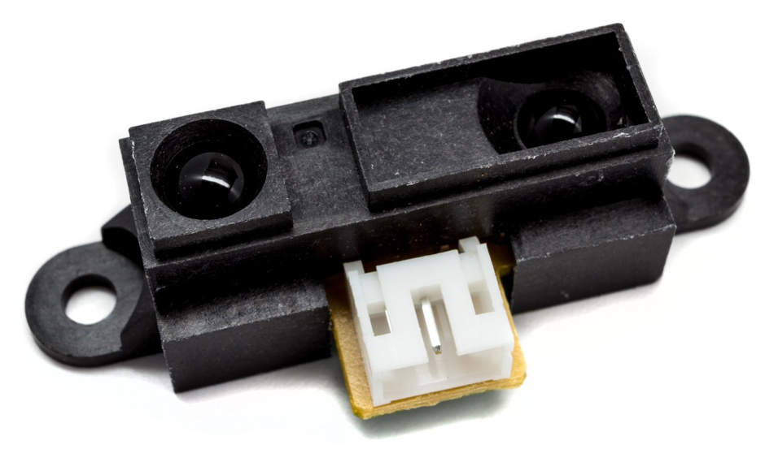
Distance sensors/Direction sensors :
Ultrasonic: An Ultrasonic sensor is a device that can measure the distance to an object by using sound waves. It measures distance by sending out a sound wave at a specific frequency and listening for that sound wave to bounce back. By recording the elapsed time between the sound wave being generated and the sound wave bouncing back, it is possible to calculate the distance between the sonar sensor and the object.
IR Sensors work by using a specific light sensor to detect a select light wavelength in the Infra-Red (IR) spectrum.

Slide 6
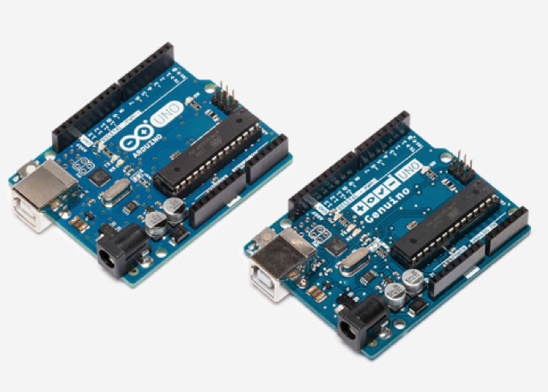
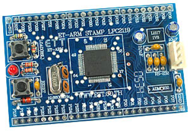
Microcontroller:
Arduino/Genuino Uno is a microcontroller board based on the ATmega328P (datasheet). It has 14 digital input/output pins (of which 6 can be used as PWM outputs), 6 analog inputs, a 16 MHz quartz crystal, a USB connection, a power jack, an ICSP header and a reset button.
ET ARM Stamp LPC 2119

Slide 7
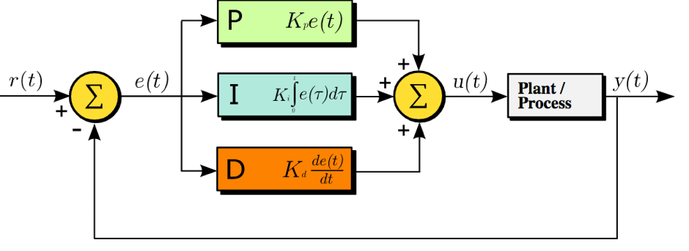
Control strategy:
A PID controller continuously calculates an error value as the difference between a desired set point and a measured process variable and applies a correction based on proportional, integral, and derivative terms (sometimes denoted P, I, and D respectively) which give their name to the controller type.

Slide 8
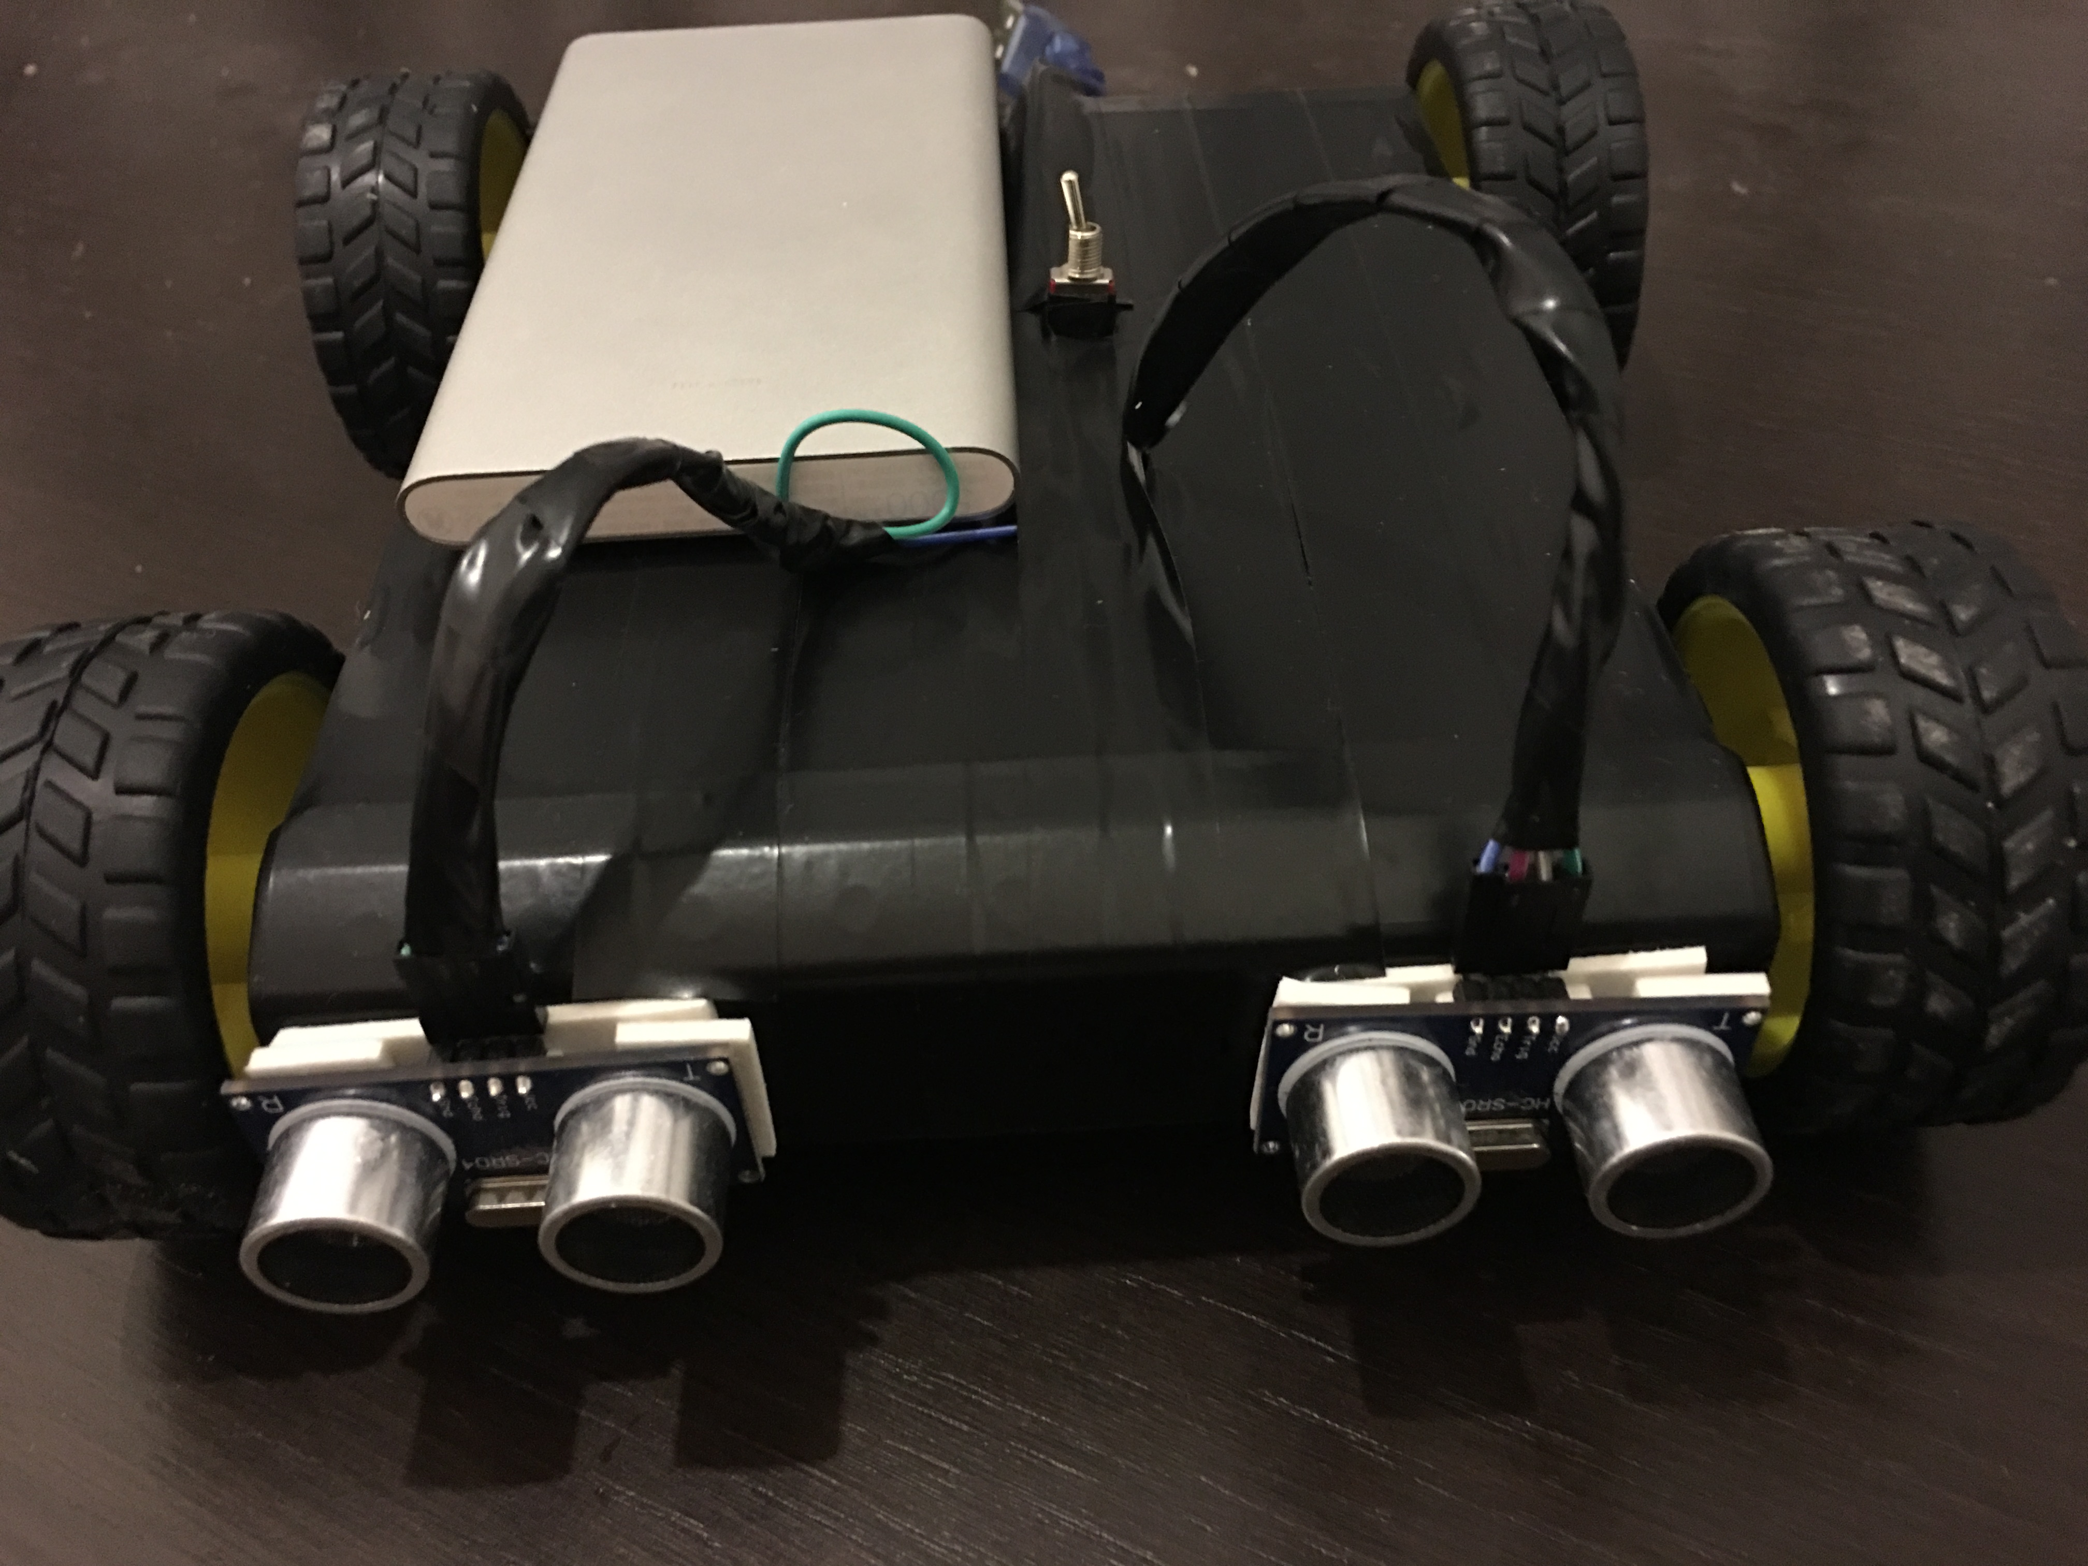
Implementation:
We had few stages of checking:
Check the response of 4 DC motors, rotation speed of the wheels, direction of the rotation.
Second step is checking of Ultrasonic sensor with Serial monitor (the working distance in our case is 0-30 cm).
Connecting motors with Ultrasonic sensor and correct the direction of movement according to the distance.

Slide 9
Conclusion:
As a result, our project could follow the necessary object, it works almost great. There are always a lot of space for improvement.
Thank you for attention!

